Slide 1

iSport
By
Oliva Gianluigi

Slide 2
Index
What is iSport
Goals
Architecture
Sequence Diagram
User Interface
Testing

Slide 3
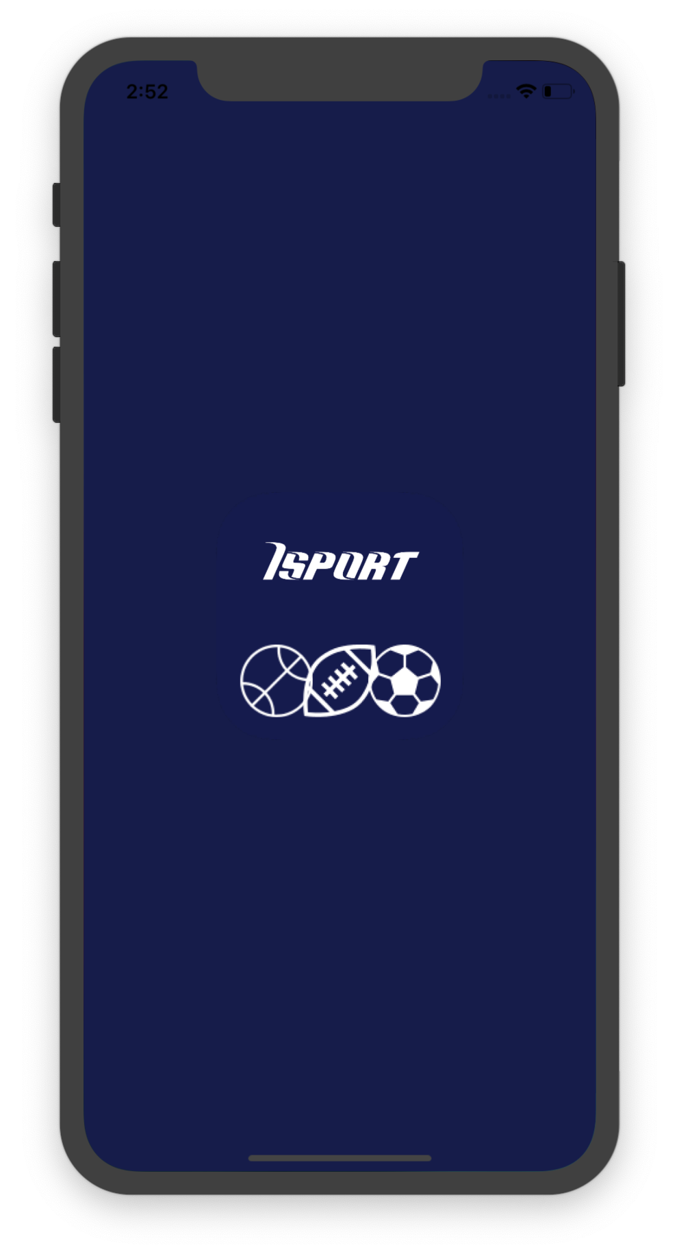
What is iSport
iSport è un’applicazione per:
Visualizzare notizie
Condividere notizie
Conoscere lo stato delle partite
Comporre e acquistare schedine
Creare una community

Slide 4
Goals
News:
View daily news
Save favorite news
Share news on Facebook
Bet:
Compose your ticket
View the potential winning
Purchase ticket
Live:
View football match result
View match details
Chat:
Chat with other users

Slide 5





Architecture
Swift for development
CoreData for Database
External Services

Slide 6
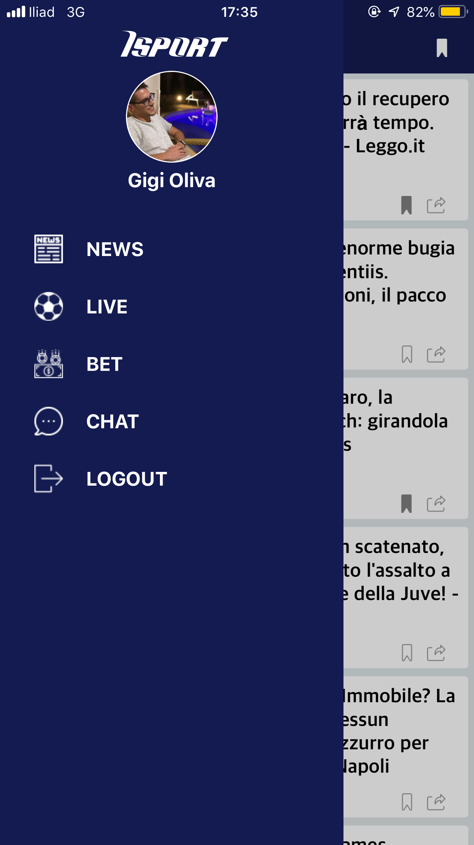
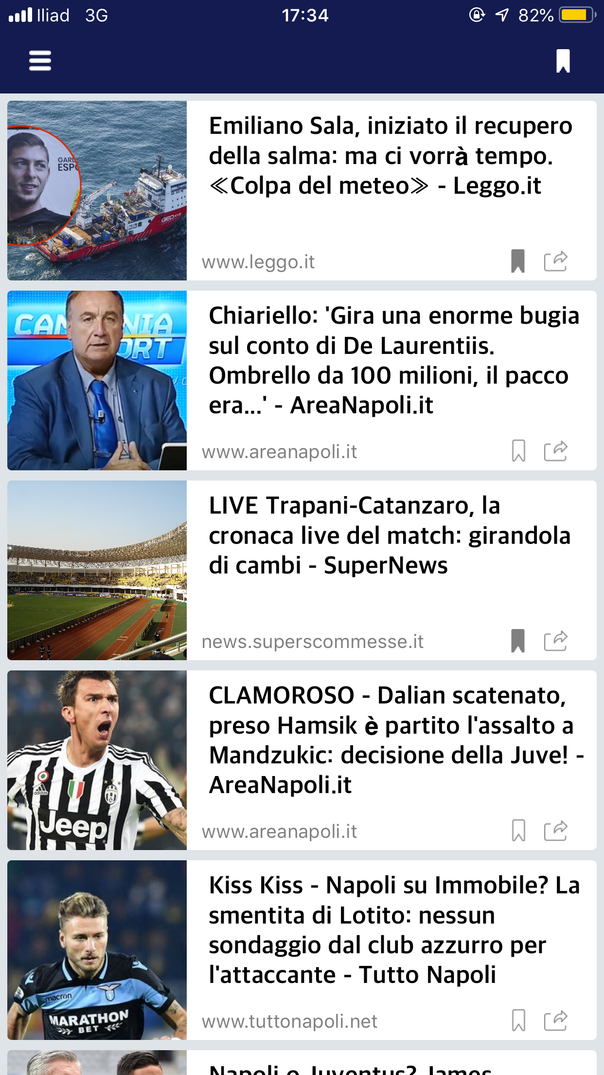
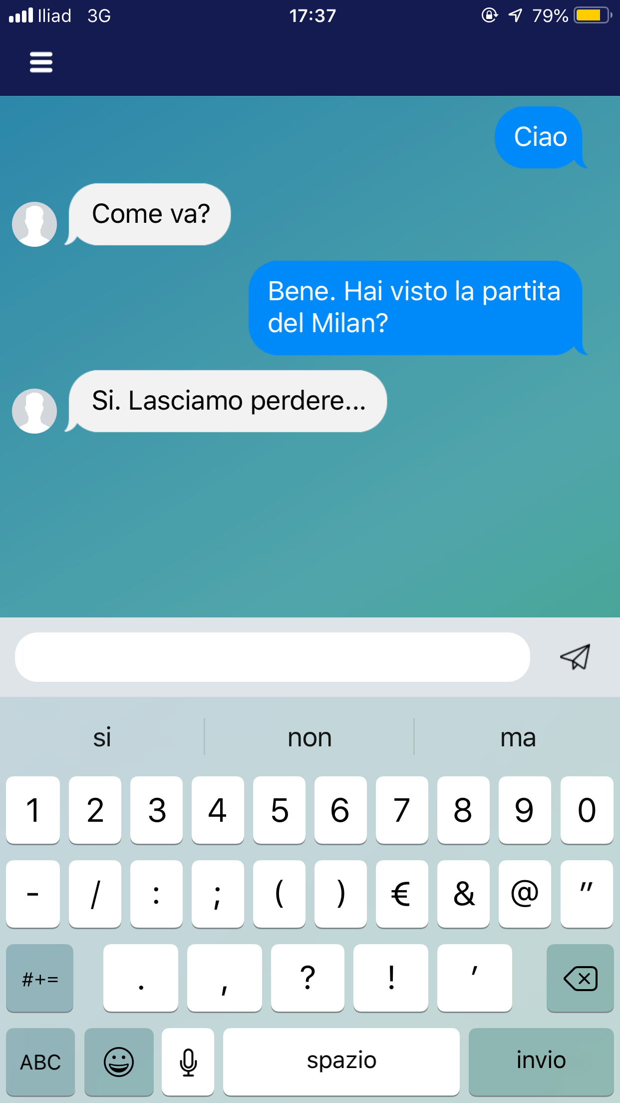
User Interface
Login
News
Chat

Slide 7
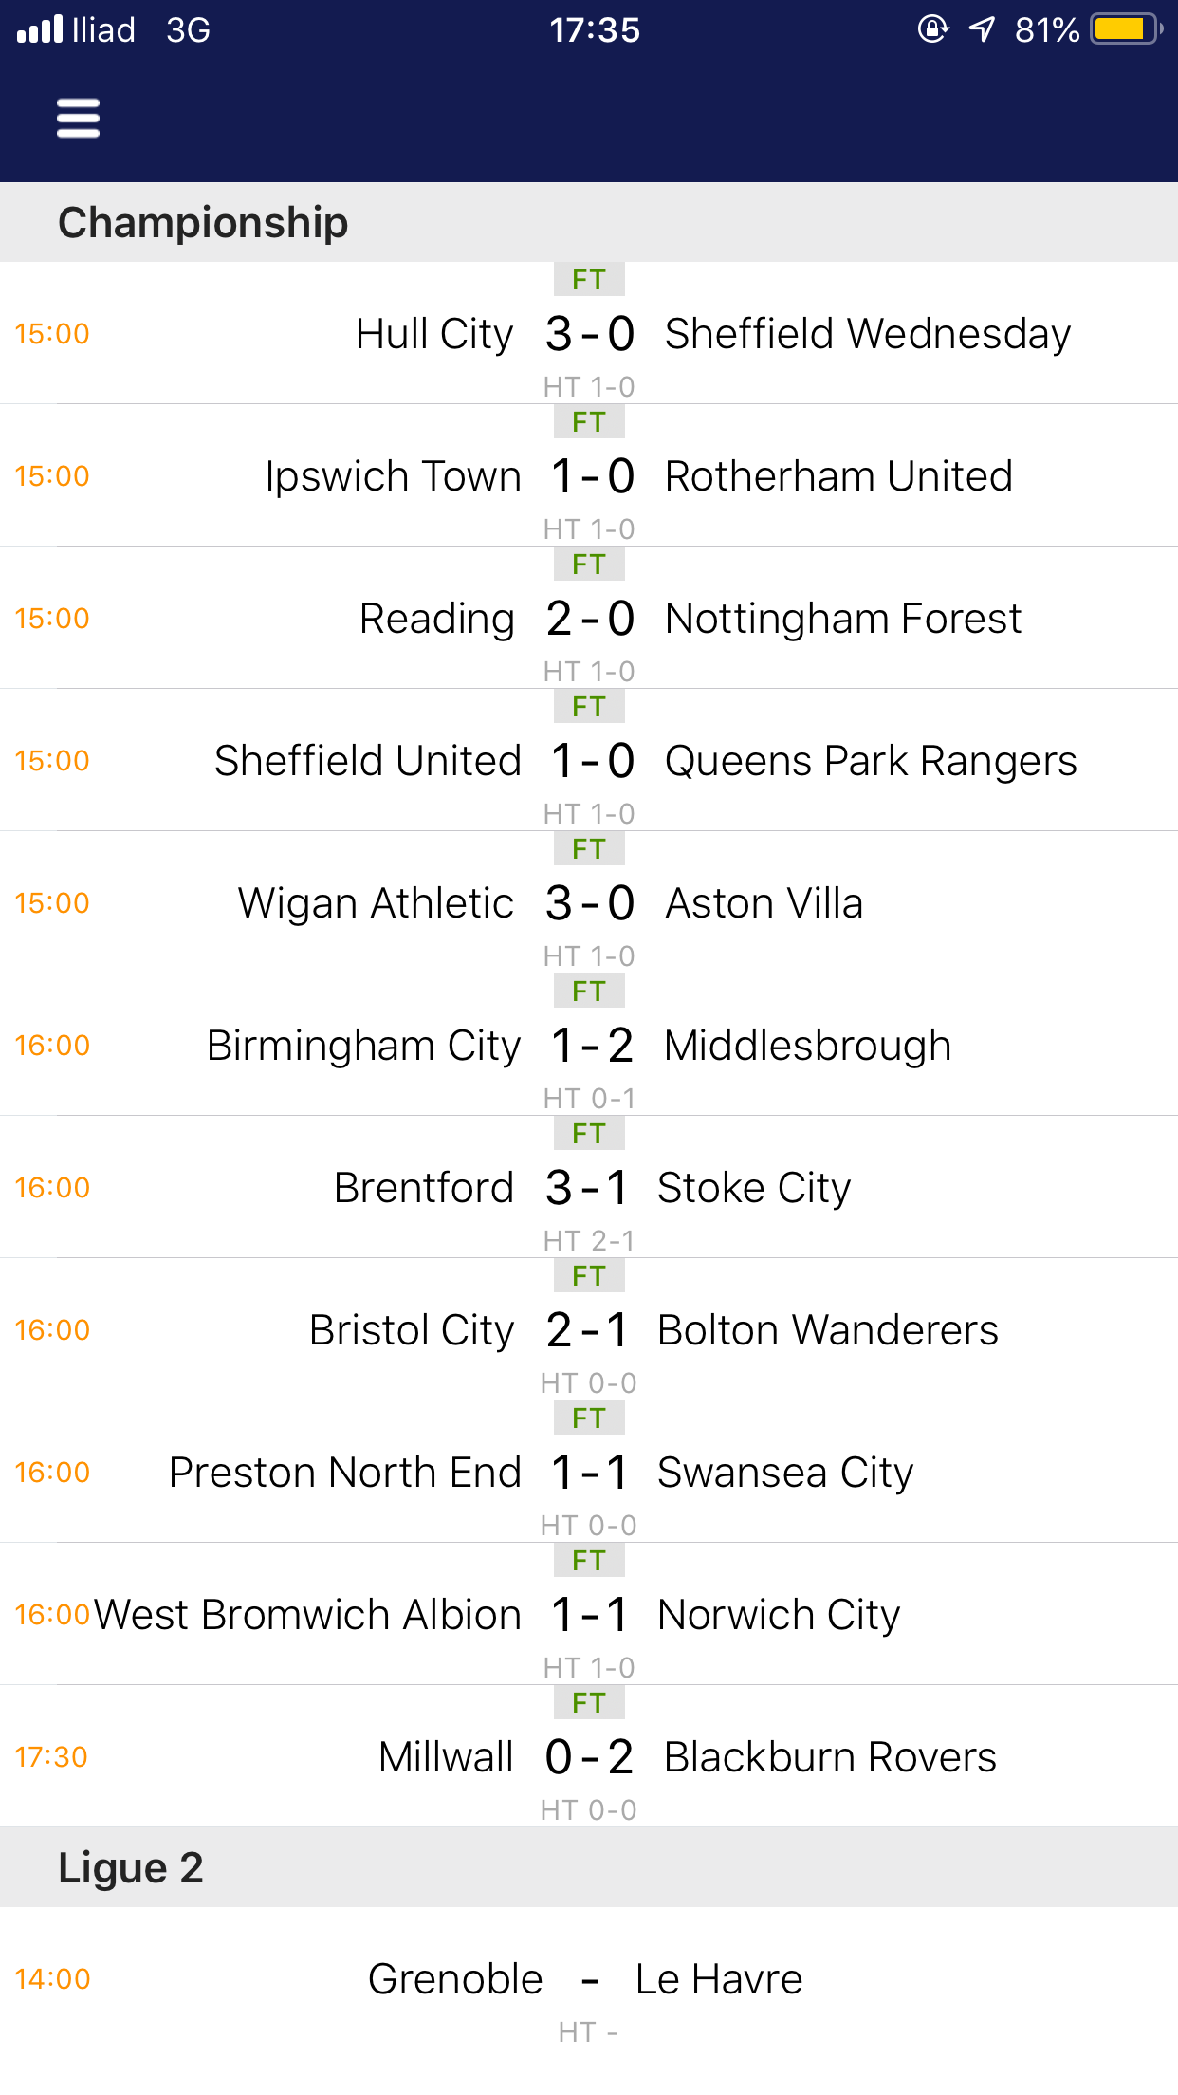
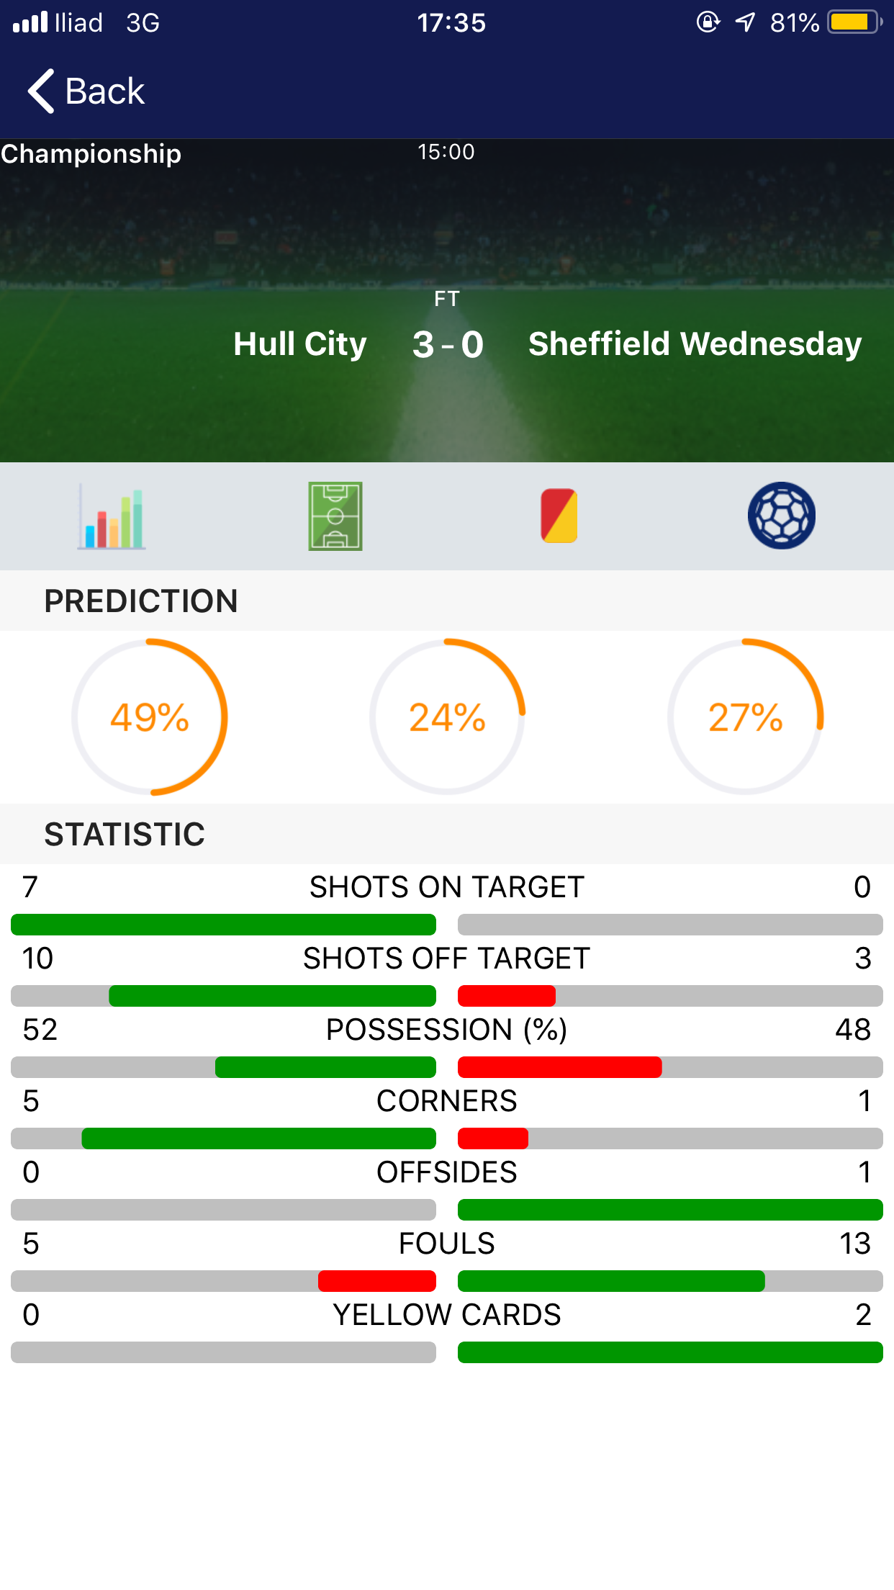
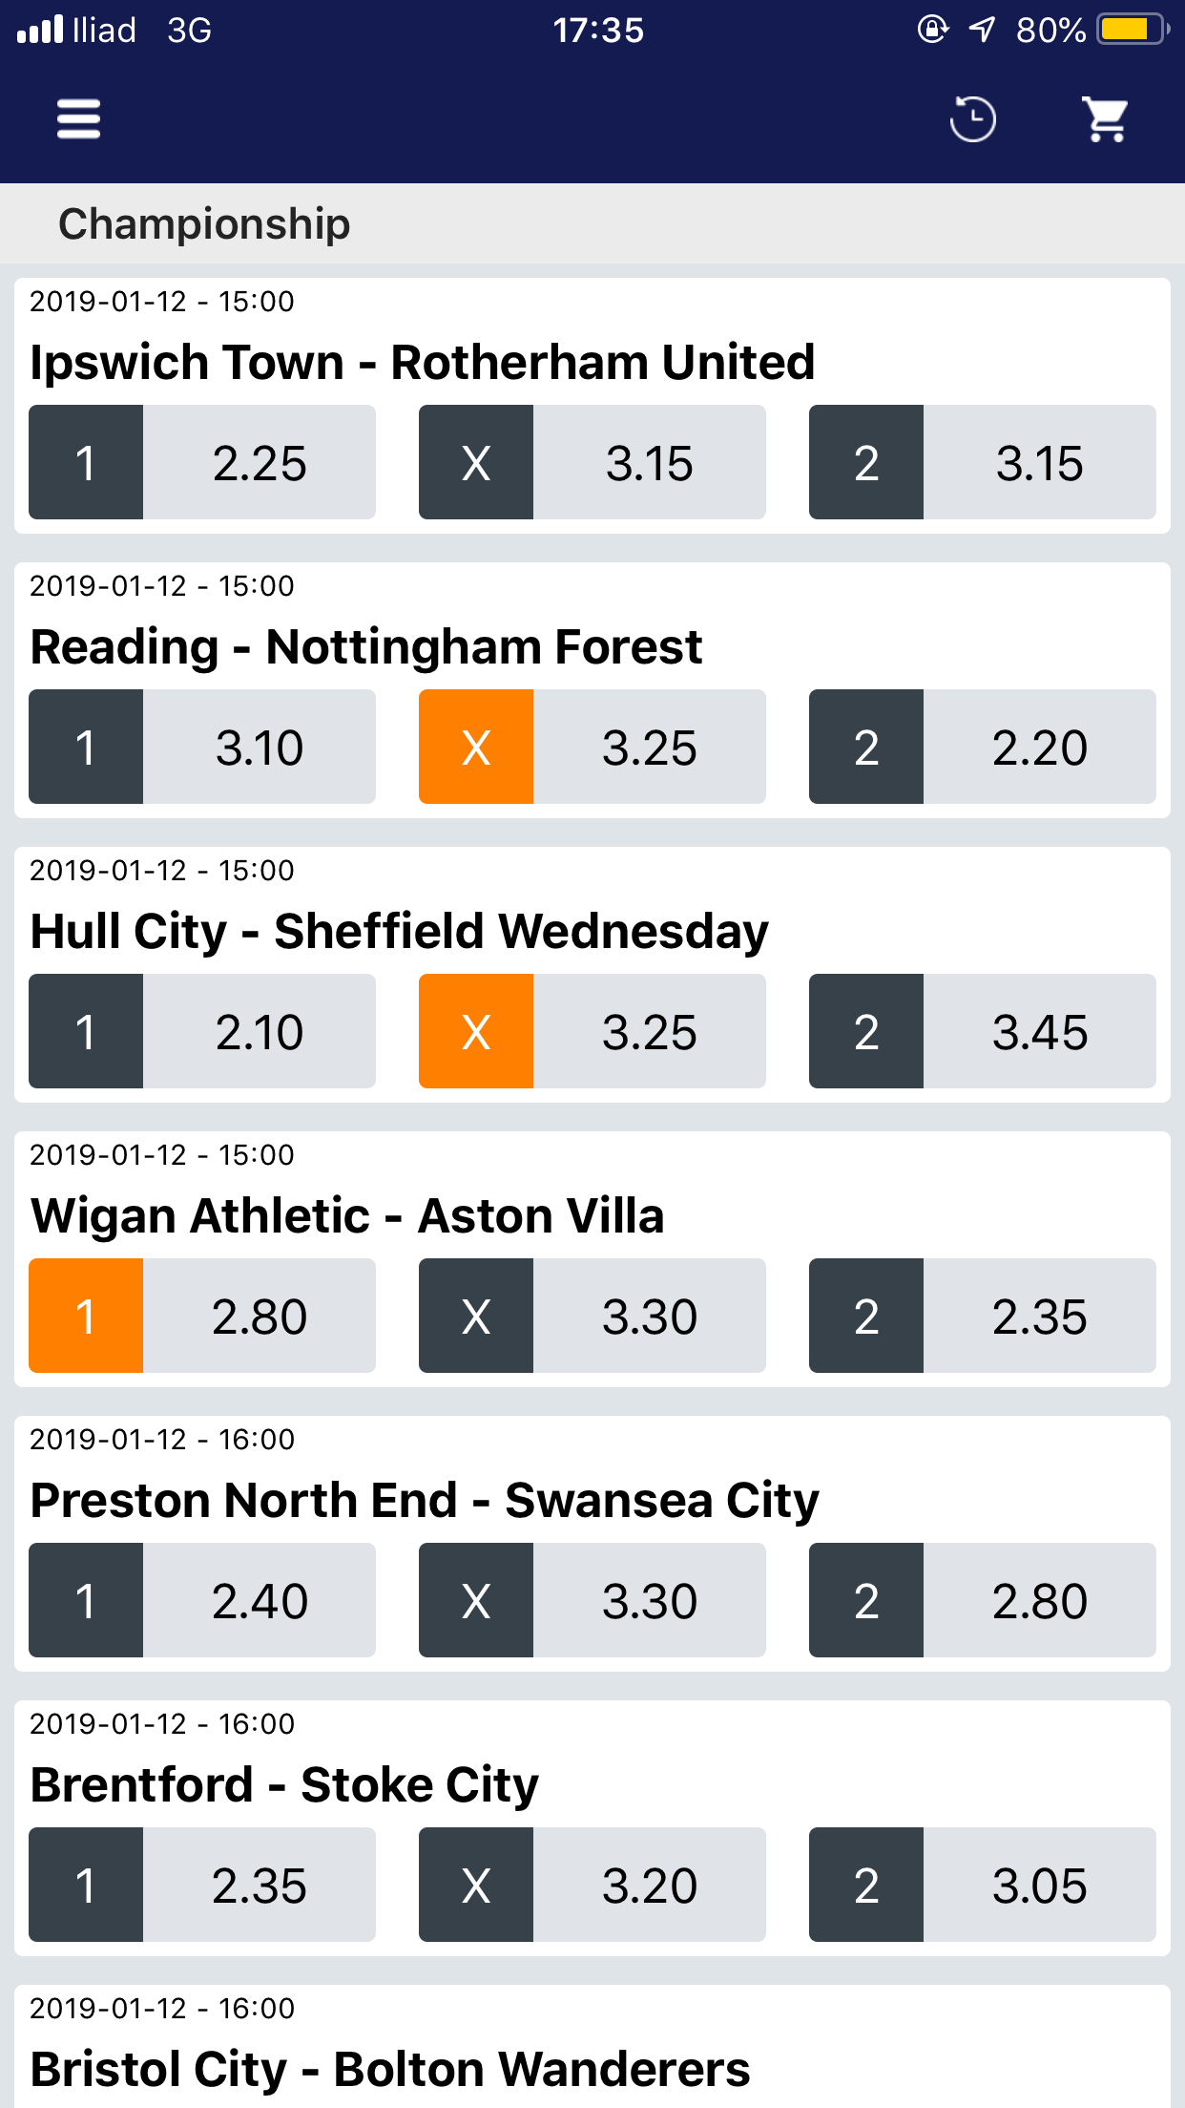
User Interface
Live
Match Details
Ticket

Slide 8
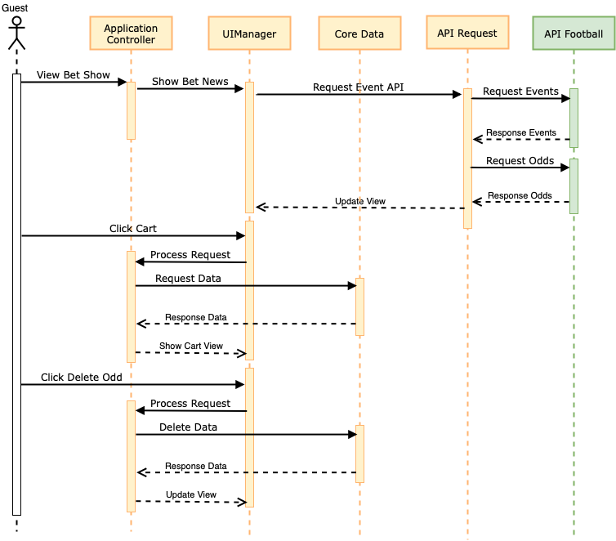
Sequence Diagram

Slide 9
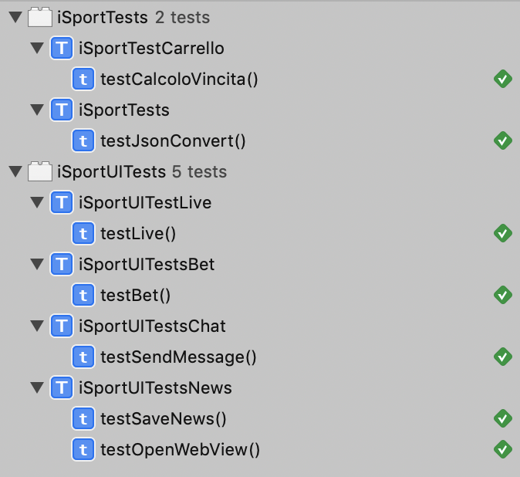
Testing

